Slide 1


Introduction To Python
Team 3
Harshagiri
Nagendra
Sumit

Slide 2
List
Lists are another cornerstone data type in Python used to specify an ordered sequence of elements.
Each value inside a list is called an item and these are placed between square brackets.

Slide 3
List
list.append(<element to append>) element gets added at the end of the list. Only one element at a time
beta_list = ["apple", "banana", "orange"]
beta_list.append("grape")
list.extend(<element/elements to append) all elements are added at the end of list
aList = [123, 'xyz', 'zara', 'abc', 123]
bList = [2009, 'manni’]
aList.extend(bList)
list.insert(<element index>, <element to insert>) #Inserts in the given index to insert, rest all elements are shifted right
beta_list = ["apple", "banana", "orange"]
beta_list.insert("2 grape")

Slide 4
List
del(<pass the index / when value is not known>)
beta_list = ["apple", "banana", "orange"]
del beta_list [1]
list.remove(<pass the index / indices to remove elements>)
beta_list = ["apple", "banana", "orange"]
beta_list.remove("apple")
list.pop(<pass the index to remove element>)
beta_list = ["apple", "banana", "orange"]
beta_list.pop()

Slide 5
List
list.sort() # sorts elements in original list itself from smallest to largest
alpha_list = [34, 23, 67, 100, 88, 2]
alpha_list.sort()
list.count(obj) # returns count of how many times obj occurs in list
aList = [123, 'xyz', 'zara', 'abc', 123]
aList.count(123)
list[index] = new_value # Overwrite the element at index by new_value
beta_list = ["apple", "banana", "orange"]
beta_list[1] = "pear"

Slide 6

Numpy Pandas Visualization

Slide 7
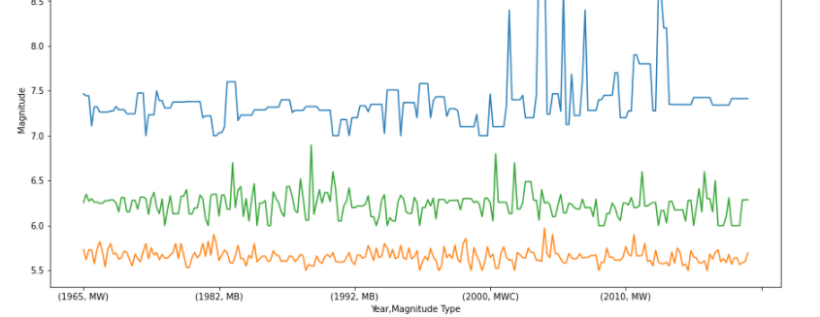
NPV – Trivariant

Slide 8
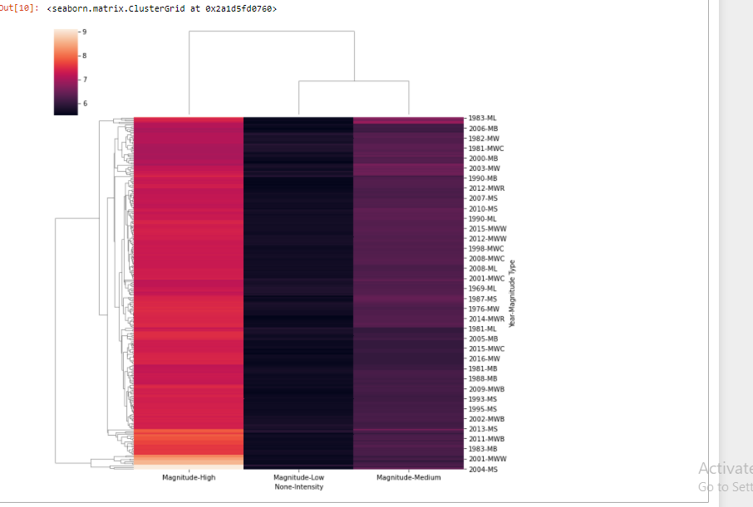
NPV – Multivariant

Slide 9
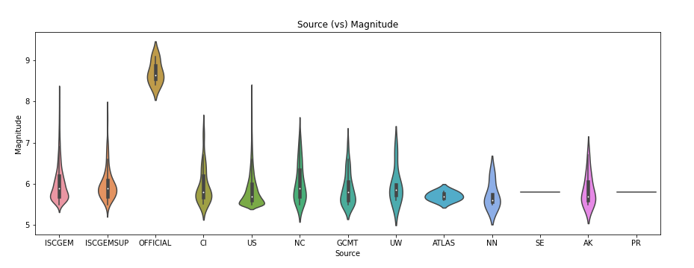
NPV - Bivariant

Slide 10
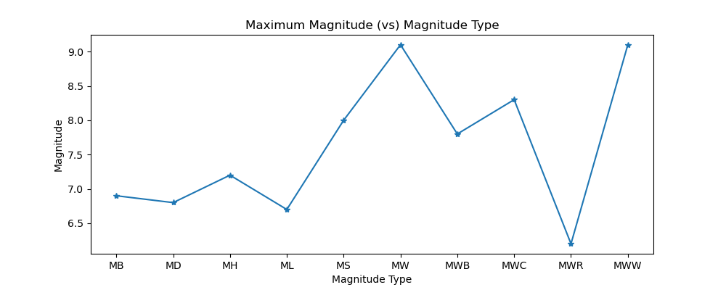
NPV - Bivariant

Slide 11
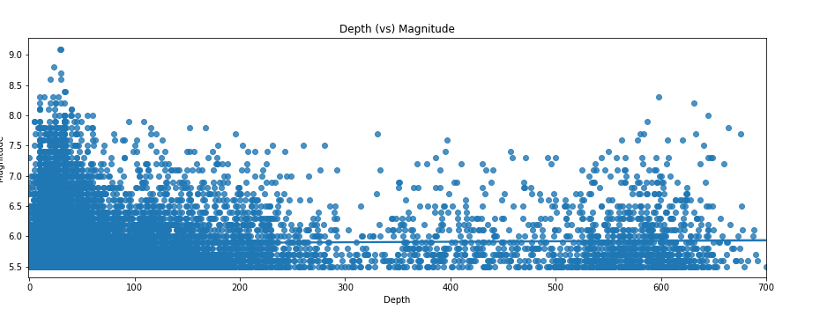
NPV - Bivariant

Slide 12
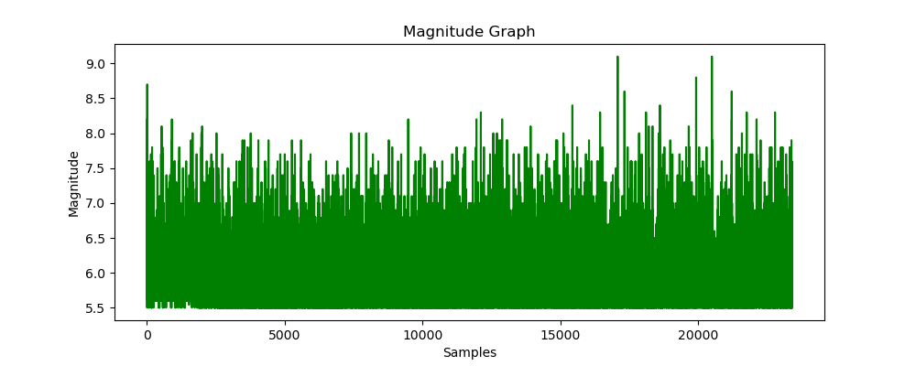
NPV – Univariant

